Slide 1
Production Theory and Estimation

Slide 2
Concepts
Production: transformation of inputs or resources into outputs of goods and services
Output = f (Land, Labour, Capital, Technology )
INPUTS
Fixed Inputs
Variable Inputs
Production
Short Run
Fixed Inputs and Variable Inputs
Long Run
Variable Inputs

Slide 3
Concepts
Variable Input - An input whose quantity can be changed in fixed time period according to the level of production.
Fixed Input - A factor of production (input) that cannot be changed in a fixed time period.
Short run - Short run is that period of time in which at least one variable input can be changed. Value of fixed input can't be changed.
Long run - Long run is that period of time in which both fixed and variable input can be changed. Value of fixed as well as variable input can be increases or decreased. Hence there is no fixed inputs in Long run

Slide 4
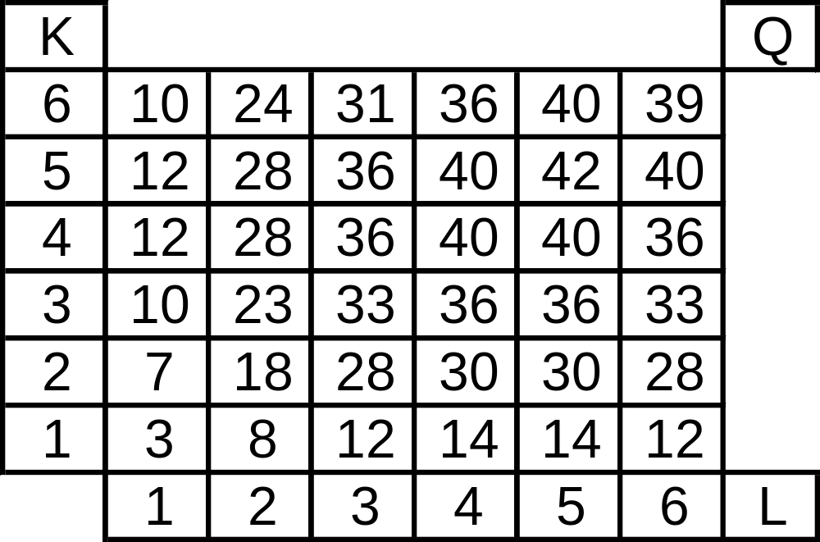
Short Run Production Function with One Variable Input
Q = f (L, K*)
Production Matrix
Capital
Labour

Slide 5
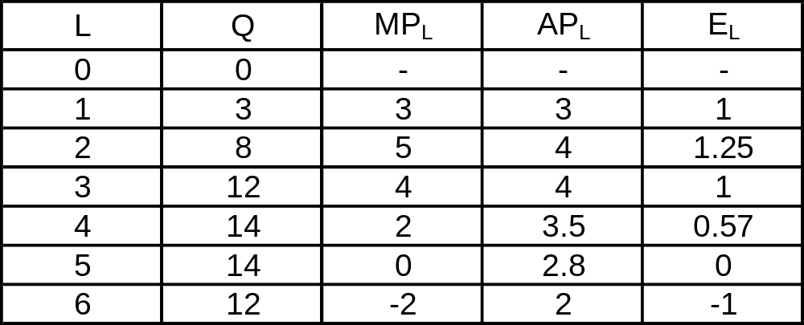
Short Run Production Function with One Variable Input
MP_{L} =
ΔTP
ΔL
TP = Q = f(L)
Marginal Product
Total Product
TP
L
Production or
Output Elasticity
MP_{L}
AP_{L}
Average Product
AP_{L} =
E_{L} =

Slide 6
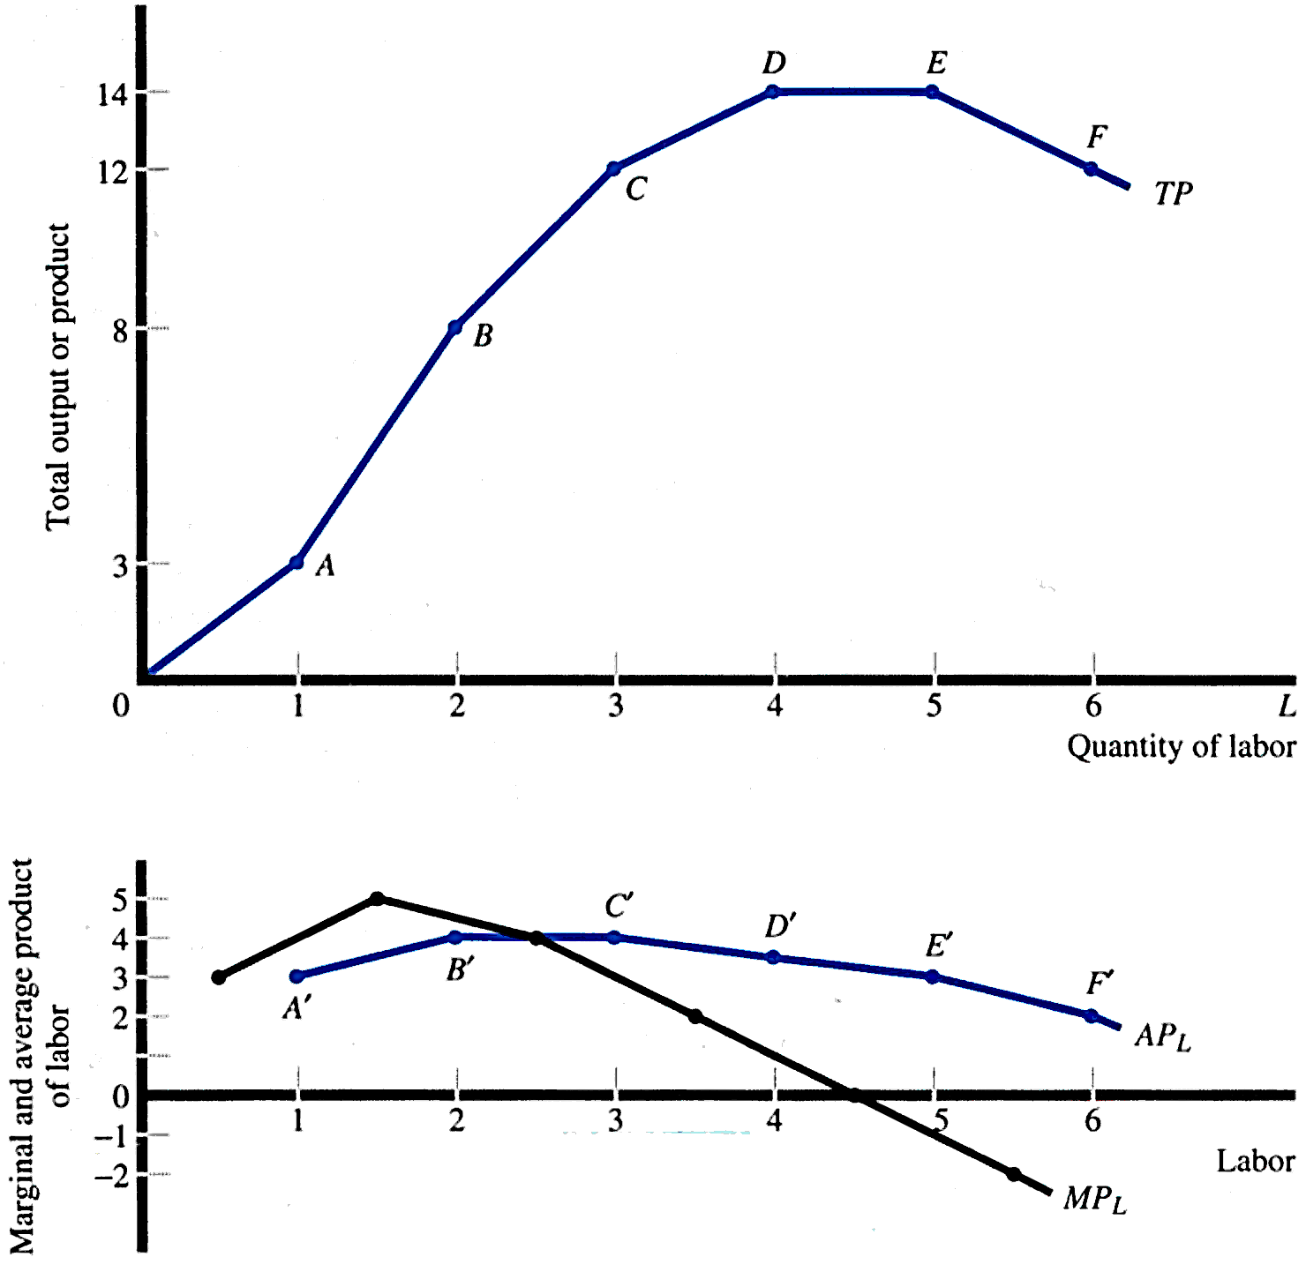
Short Run Production Function with One Variable Input

Slide 7
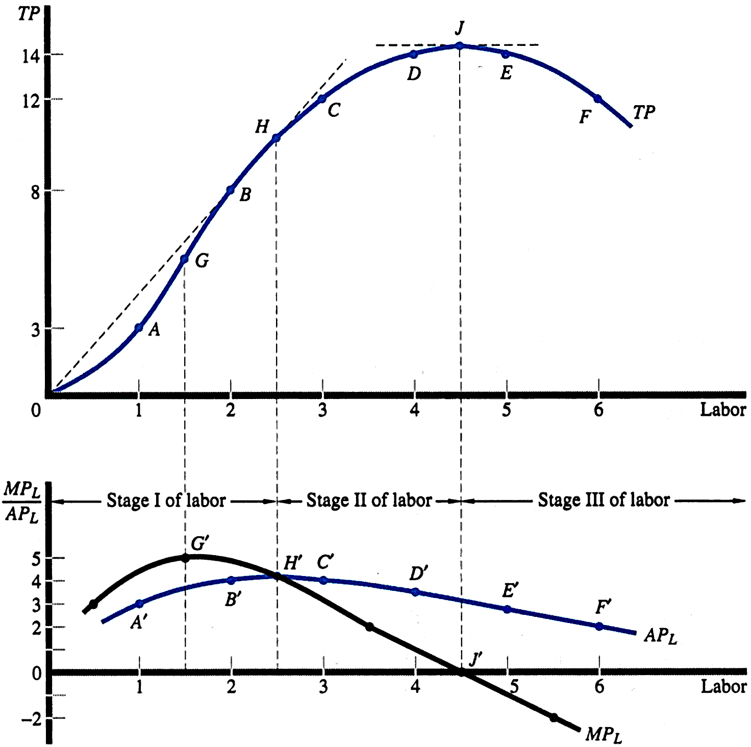
Short Run Production Function with One Variable Input

Slide 8
Law of Variable Proportion
The declining proportion of MPL is reflection of the Law of Diminishing Return
The relationship between MPL and APL can be used to define three stages of production for Labour.
Stage 1: from the origin to the point where APL is maximum (point H’)
Stage 2: from the point where APL is maximum to where MPL is zero (point H’ to J’)
Stage 3: the range over which MPL is negative
(past point J’)

Slide 9
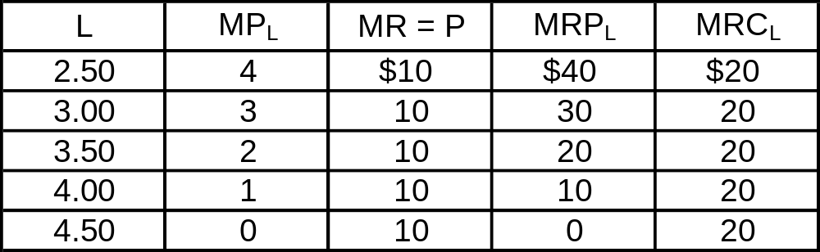
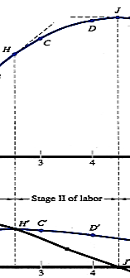
Optimal Use of the Variable Input
Marginal Revenue
Product of Labor
MRP_{L} = (MP_{L})(MR)
Marginal
Cost of Labor
ΔTC
ΔL
MRC_{L} =
Optimal Use of Labor
MRP_{L} = MRC_{L}
Use of Labor is Optimal When L = 3.50

Slide 10
Optimal Use of the Variable Input
MRP_{L}
MRP_{L} MRC_{L}
MRC_{L}

Slide 11
Short Run Production Function:
With Two Variable Input

Slide 12
Short Run Production Function with Two Variable Input
Q = f (L, K, T*)
Production Matrix

Slide 13
Short Run Production Function with Two Variable Input
Q = f (L, K, T*)
Production Matrix

Slide 14
Short Run Production Function with Two Variable Input
L | K
2 | 5
2 | 4
3 | 2
6 | 2
L | K
4 | 6
3 | 5
3 | 4
4 | 3
5 | 3
6 | 4
Q (28)= f (L, K)
Q (36)= f (L, K)

Slide 15
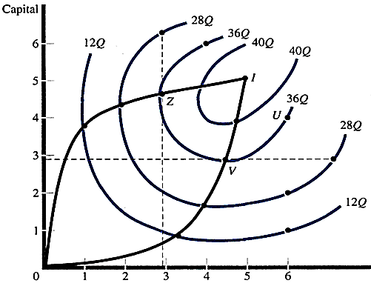
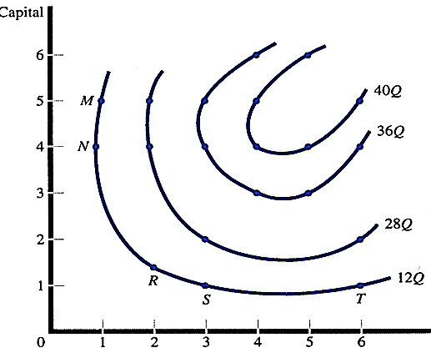
Isoquants
Economic Region of Production
Isoquants
Labour
Labour
At upper ridge line, the marginal product of capital is zero, while the lower ridge line implies that the marginal product of labour is zero. The production techniques are technically efficient only in the region inside the two ridge lines.
Isoquants: all possible combinations of inputs that result in the production of a given level of output

Slide 16
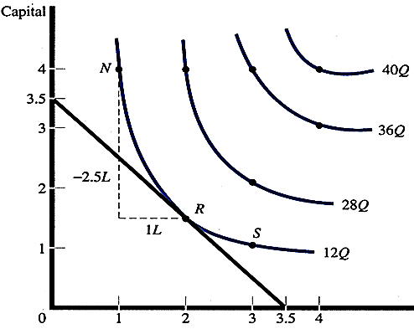
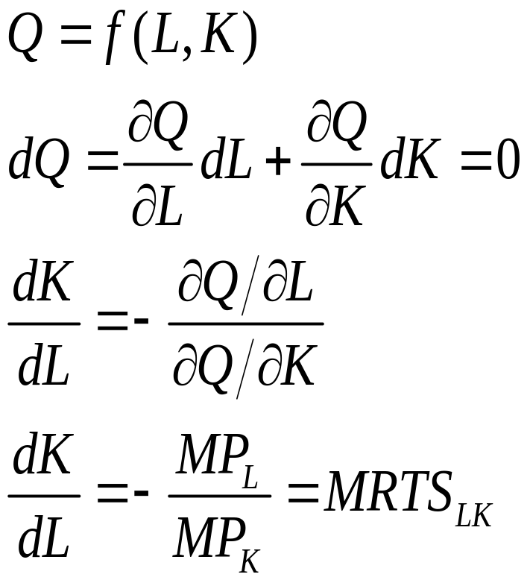
Marginal Rate of Technical Substitution
_{K}
Labour
MRTS: the tradeoffs between factors, such as capital and labor, that a firm must make in order to keep output constant
MRTS = -ΔK/ΔL = MP_{L}/MP_{K}

Slide 17
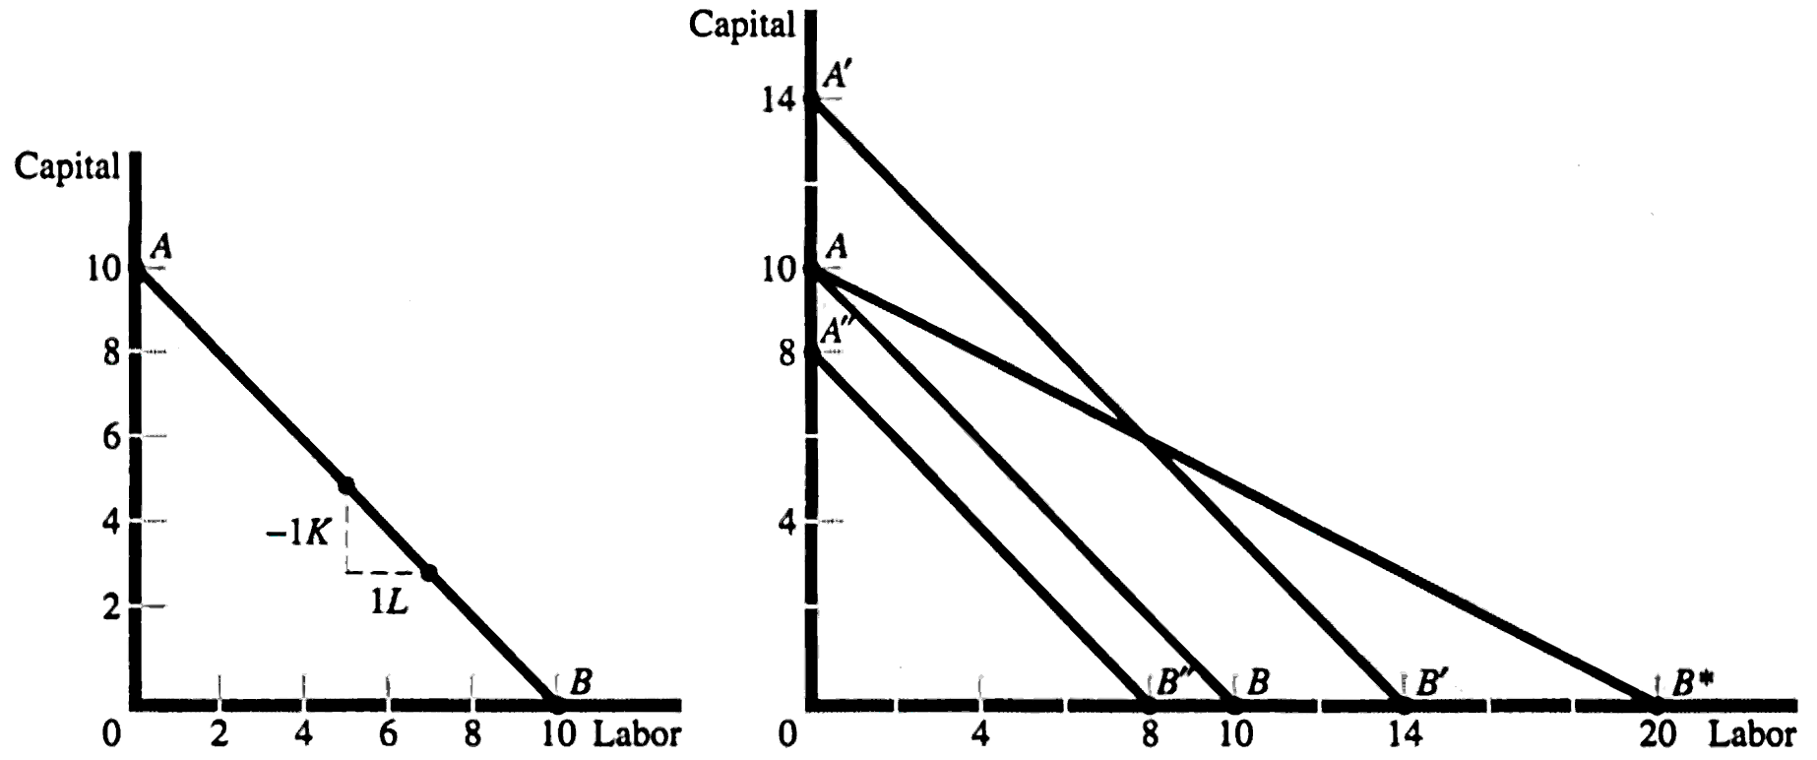


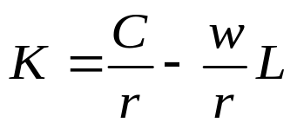


Isocost Lines
Isocost Lines
AB C = 100, w = r = 10
A’B’ C = 140, w = r = 10
A’’B’’ C = 80, w = r = 10
AB* C = 100, w = 5, r = 10
Isocost line: all the possible combinations of two factors that can be used at given costs and for a given producer’s budget

Slide 18
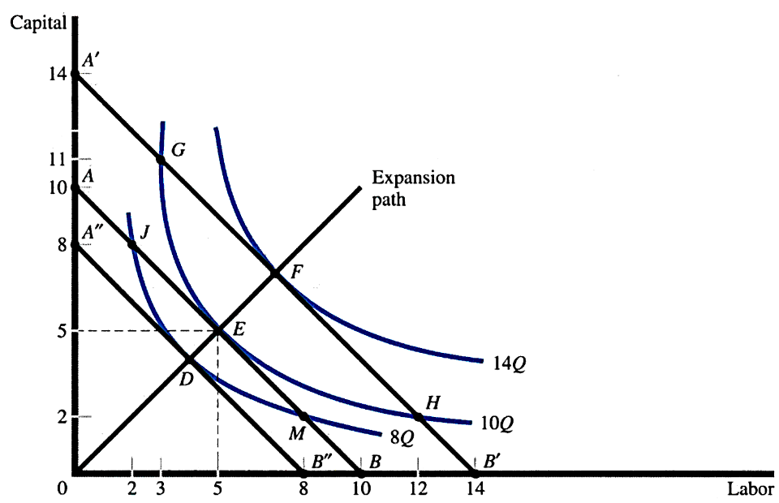
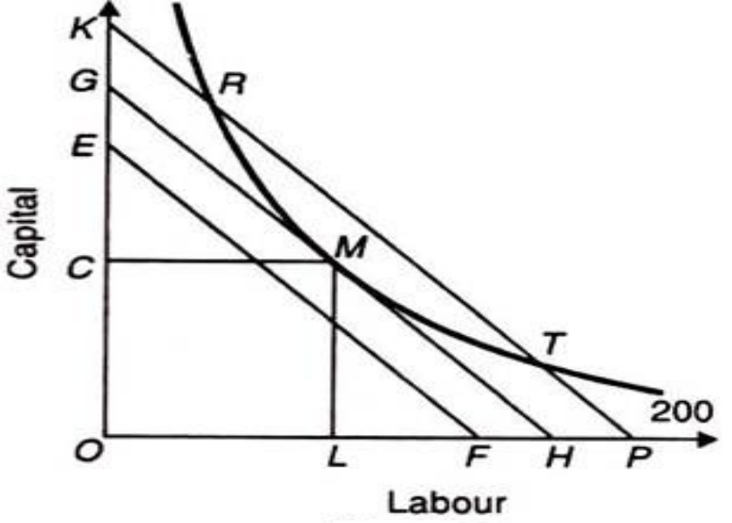
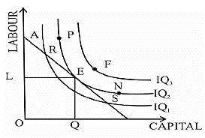
Isoquant analysis :The Economically Efficient Point of Production
MRTS = w/r
Slope of Isoquant = Slope of Isocost
Output Maximization
Cost Minimization

Slide 19

Producer’s Equilibrium
Output Maximization
Cost Minimization

Slide 20


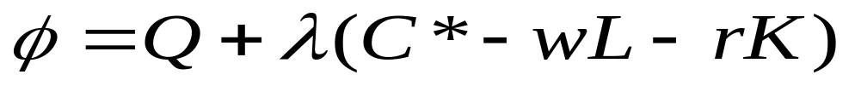
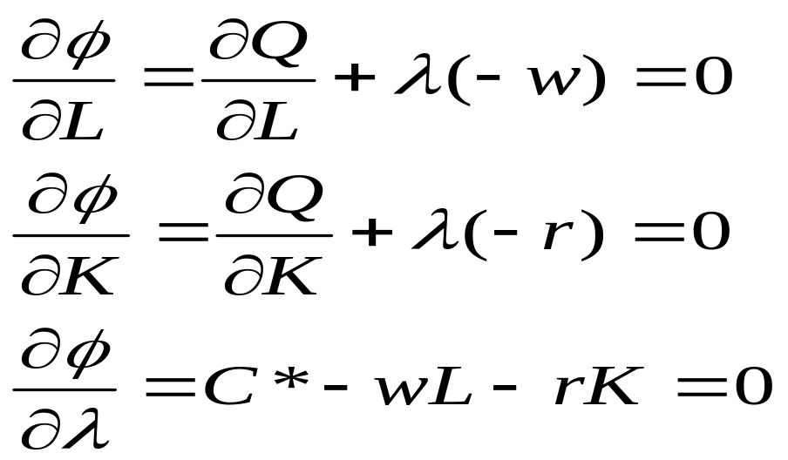

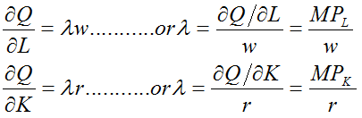

Mathematical Derivations: Output Maximization
Maximize
Subject to
Composite function with Lagrangian multiplier
… 1
Differentiating the composite function with respect to L and K and
… 2
… 3

Slide 21
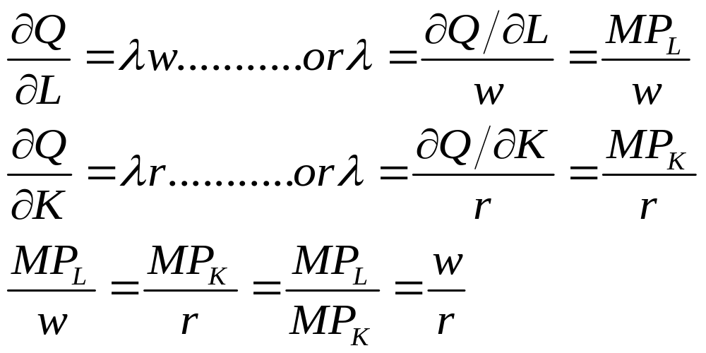
Mathematical Derivations: Output Maximization
Solving EQ1, and EQ2
Equilibrium condition

Slide 22


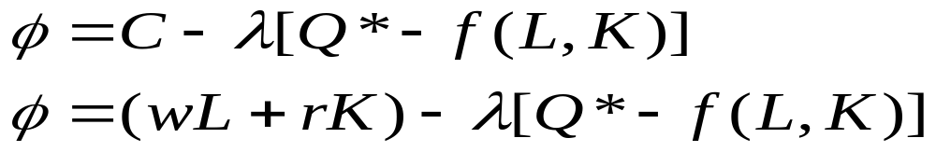
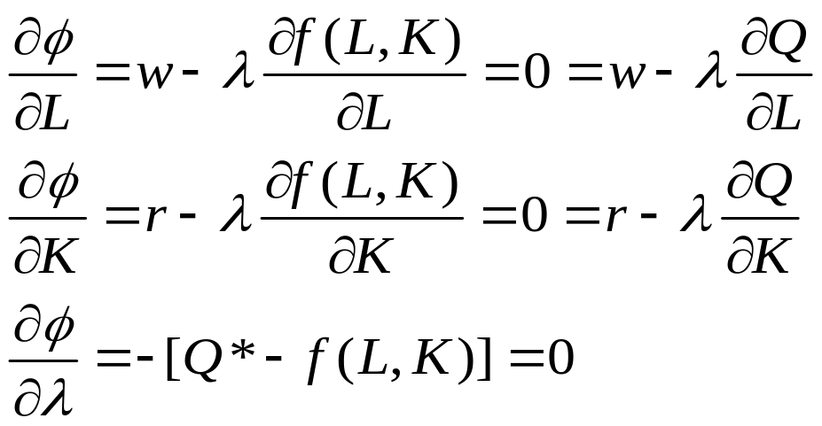
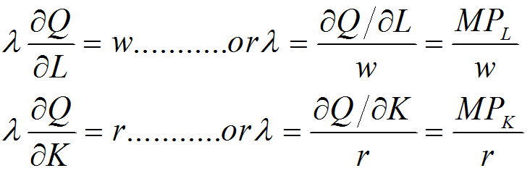
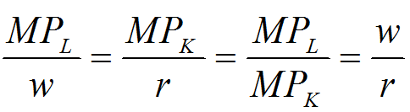
Mathematical Derivations: Cost Minimization
Minimize
Subject to
Composite function with Lagrangian multiplier
Differentiating the composite function with respect to L and K and
… 1
… 2
… 3

Slide 23
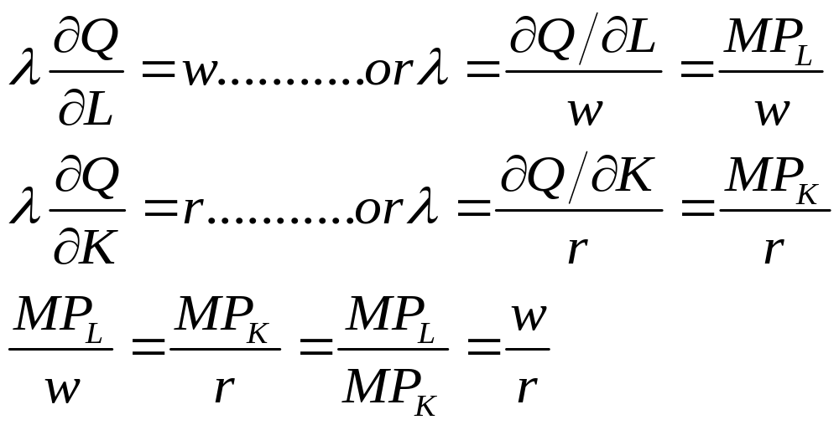
Mathematical Derivations: Cost Minimization
Solving EQ1, and EQ2
Equilibrium condition

Slide 24
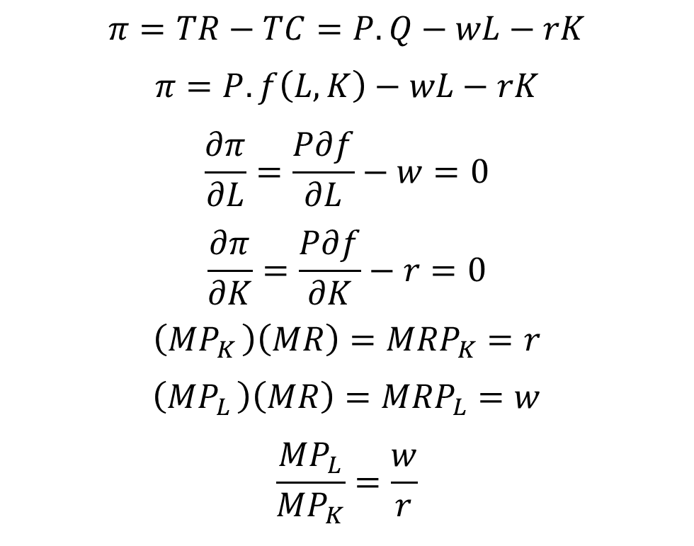
Profit Maximization
The necessary condition for choosing the level of q that maximizes profits can be found by setting the derivative of the π function with respect to q equal to zero
… 1
… 2

Slide 25

Examples
Given the following information:
Production function :
Total Cost : C*=1000,
W (Wage Per Unit of Labour)=30
R (Rent Per Unit of Capital)= 40
Determine the amount of Labour and capital that the firm should use in order to maximize output and what is the level of output?
Given the following information:
Production function :
W (Wage Per Unit of Labour)=50
R (Rent Per Unit of Capital)= 40
Determine the amount of Labour and capital that the firm should use in order to minimize the cost of producing 1118 unit of output and what is the minimum cost?

Slide 26
Long run Production Function

Slide 27
Long run Production Function
Returns to Scale: the behavior of the rate of increase in output (production) relative to the associated increase in the inputs (the factors of production) in the long run
Production Function Q = f(L, K)
λQ = f(hL, hK)
If output increases by that same proportional change as all inputs change then there are constant returns to scale (CRS)
If λ = h, then f has constant returns to scale.

Slide 28
Long run Production Function
If output increases by more than that proportional change in inputs, there are increasing returns to scale (IRS)
If λ > h, then f has increasing returns to scale.
If output increases by less than that proportional change in inputs, there are decreasing returns to scale (DRS).
If λ < h, the f has decreasing returns to scale.
Note: A firm's production function could exhibit different types of returns to scale in different ranges of output. Typically, there could be increasing returns at relatively low output levels, decreasing returns at relatively high output levels, and constant returns at one output level between those ranges.
The returns to scale faced by a firm are purely technologically imposed and are not influenced by economic decisions or by market conditions

Slide 29
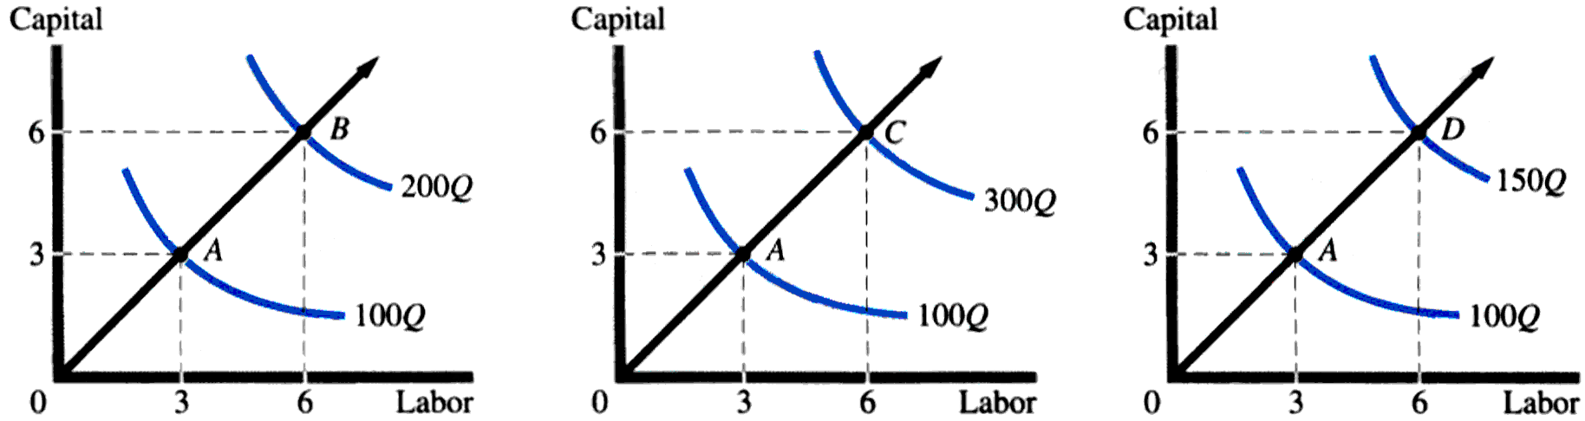
Long run Production Function
Constant
Returns to Scale
Increasing Returns to Scale
Decreasing
Returns to Scale

Slide 30
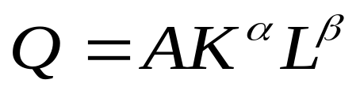
Empirical Production Functions
Cobb-Douglas Production Function: is a particular functional form of the production function, widely used to represent the technological relationship between the amounts of two or more inputs, particularly physical capital and labor, and the amount of output that can be produced by those inputs.
Cobb, C. W.; Douglas, P. H. (1928). "A Theory of Production". American Economic Review 18 (Supplement): 139–165
Standard form for production of a single good with two factors, the function is
where:
  Q = total production; L = labor input; K = capital input; A = total factor productivity
α and β are the output elasticities of capital and labor, respectively. These values are constants determined by available technology.

Slide 31
Empirical Production Functions
Output elasticity measures the responsiveness of output to a change in levels of either labor or capital used in production, ceteris paribus. For example, if α = 0.45, a 1% increase in capital usage would lead to approximately a 0.45% increase in output.
Further, if
  α + β = 1,
the production function has constant returns to scale, meaning that doubling the usage of capital K and labor L will also double output Y. If
  α + β < 1,
returns to scale are decreasing, and if
  α + β > 1,
returns to scale are increasing.

Slide 32
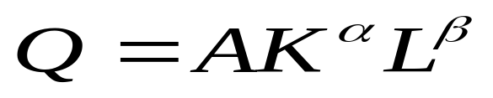
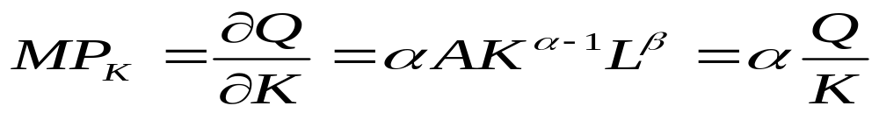
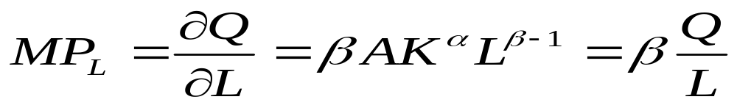
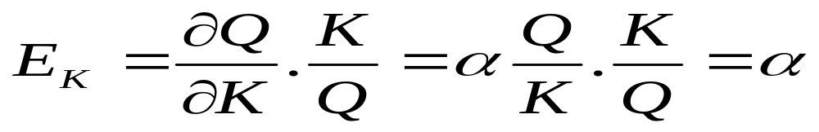
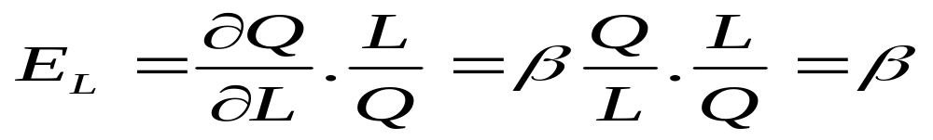
Cobb-Douglas Production Function

Slide 33
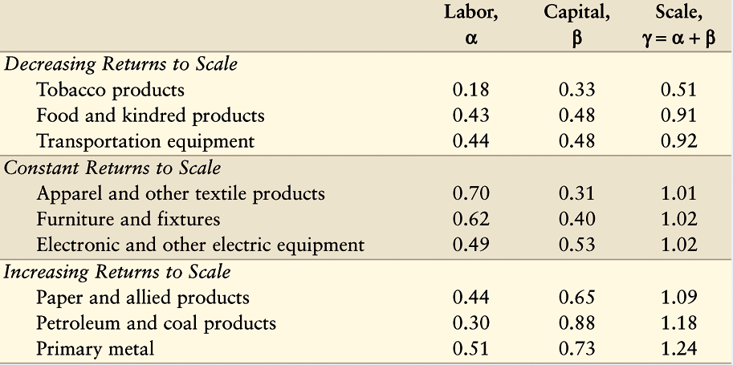
Examples

